Slide 1


Slide 2
Web Technologies and Programming
Lecture 25

Slide 3
Validating User Input

Slide 4
Summary of Previous Lecture
Passing Form Data
action
method (POST or GET)
When to Use GET?
When to Use POST?
Compare GET vs. POST
Super Global Variables

Slide 5
Summary of Previous Lecture
Passing data with forms
Passing Text Field Data
Passing Hidden Field Data
Getting Value From Checkbox
Getting Value From Radio Button
Getting Value From Select List
Using session Variables

Slide 6
Today’s Lecture Outline
Regular expressions in PHP
Validating user input at server
String functions

Slide 7
1. Regular expressions in PHP
Regular expressions are sequence or pattern of characters itself. They provide the foundation for pattern-matching functionality
A regular expression is a concise notation to describe patterns in strings
Regular expressions provide the foundation for describing or matching data according to defined syntax rules
Example: |^[0-9]{2}-[0-9]{2}-[0-9]{4}$|

Slide 8
1. Regular expressions in PHP
Using regular expression you can search a particular string inside a another string, you can replace one string by another string and you can split a string into many chunks.
PHP offers functions specific to two sets of regular expression functions, each corresponding to a certain type of regular expression. You can use any of them based on your comfort.
POSIX Regular Expressions
PERL Style Regular Expressions

Slide 9
1. Regular expressions in PHP…
|^[0-9]{2}-[0-9]{2}-[0-9]{4}$|
Sub pattern with fixed character
Start and end of RE
Sub pattern
Sub pattern
Sub pattern
Start matching from the start
Match the end of the string
[0-9]
{2}
Allowed characters
length

Slide 10
1. Regular expressions in PHP…
Brackets
Brackets ([]) have a special meaning when used in the context of regular expressions. They are used to find a range of characters.
[0-9] It matches any decimal digit from 0 through 9.
Brackets: [a-Z], [A-Z], [a-z], [0-9]

Slide 11
1. Regular expressions in PHP…
Quantifiers
The frequency or position of bracketed character sequences and single characters can be denoted by a special character.
Each special character having a specific connotation. The +, *, ?, {int. range}, and $ flags all follow a character sequence

Slide 12
1. Regular expressions in PHP…
p+ : It matches any string containing at least one p.
p* : It matches any string containing zero or more p's.
p? : It matches any string containing zero or more p's. This is just an alternative way to use p*.
p{N}: It matches any string containing a sequence of N p's
p{2,3}: It matches any string containing a sequence of two or three p's.
p{2, }: It matches any string containing a sequence of at least two p's.
p$: It matches any string with p at the end of it.
^p : It matches any string with p at the beginning of it.

Slide 13
1. Regular expressions in PHP…
Start and end of the RE:
optional, ||
Sub-patterns:
range of allowed characters
[0-9]
Allowed length
{2}
Sub-patterns with fixed character

Slide 14
1. Regular expressions in PHP…
Matching from the start: ^:
1212-12-2014
Matching till end: $:
12-12-2014123
For exact match we should use both ^ and $
Pattern exists if do not match from start
Pattern exists if do not match till end

Slide 15
1.1 Notations for RE
^:
Match strings that start with the given pattern
$:
Match strings that end with the given pattern
-:
Range of characters
[ ]:
Makes a class of characters
[^ ]:
Negates the class of character

Slide 16
1.1 Notation for RE…
Quantifiers:
{n}:
matches a character, class or sub-pattern for n times
{n, m}:
matches a character, class or sub-pattern for minimum n times and maximum m times

Slide 17
1.1 Notation for RE…
?:
matches the character, class or sub-pattern 0 or 1 time
equal to {0,1}
+:
matches the character, class or sub-pattern 1 or more times
equals to {1, }
*:
matches the character, class or sub-pattern 0 or any number of time
equals {0, }

Slide 18
1.1 Notation for RE…
Predefined character ranges:
\d:
Exactly as [0-9]
\D:
Exactly as [^0-9]
\w:
Exactly as [a-zA-Z0-9]

Slide 19
1.1 Notation for RE…
RE examples:
Validating date:
|^\d{2}-\d{2}-\d{4}$|
Validating CNIC:
|^\d{5}-\d{7}-\d{1}$|
Validating Email:
|^[a-zA-Z0-9_.]+@[a-z]{3,5}.[a-z]{2,3}$|

Slide 20
1.1 Notation for RE…
Validating name:
|^[a-zA-Z ]{5,25}$|
Validating Password:
must contain ‘@’
|@|

Slide 21
2. Validating User’s Input
preg_match():
searches a string for a specific pattern
returns TRUE if it exists
retruns FALSE otherwise
preg_match(“pattern”,$string);

Slide 22
2. Validating User’s Input
preg_match_all():
The preg_match_all() function matches all occurrences of pattern in string.
preg_grep():
The preg_grep() function searches all elements of input_array, returning all elements matching the regexp pattern.

Slide 23
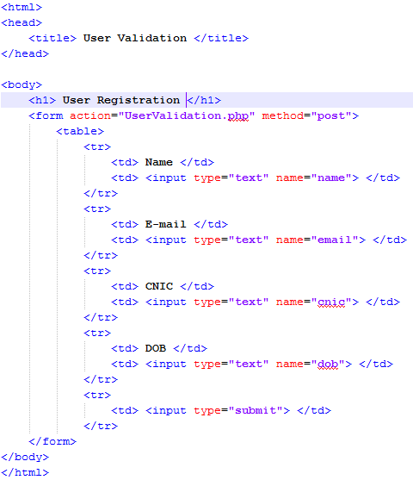
2. Validating User’s Input…

Slide 24
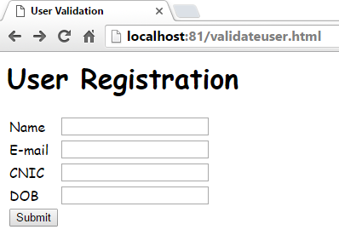
2. Validating User’s Input…
Post To UserValidation.php

Slide 25
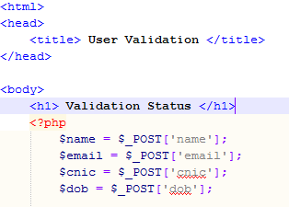
2. Validating User’s Input
Receiving Values

Slide 26
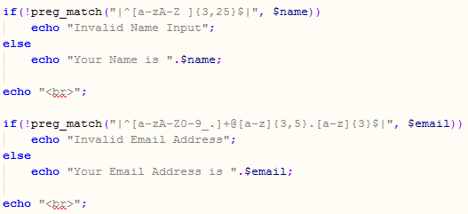
2. Validating User’s Input
Validating Name
Validating Email Address

Slide 27
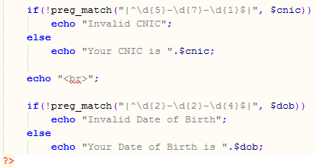
2. Validating User’s Input
Validating CNIC
Validating DoB

Slide 28
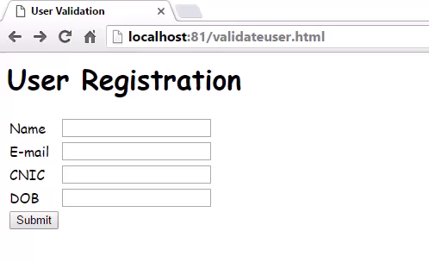
2. Validating User’s Input

Slide 29
3. String Functions in PHP
strlen():
Returns the length of the string
strlen($string);
strcmp():
Compares two strings
Returns 0 if strings are equal
1 if first string is greater than second string
-1 if second string is greater than first string
strcmp($string1, $string2);
strcasecmp():
Compares two strings in case insensitive manner
strcasecmp($string1, $string2);

Slide 30
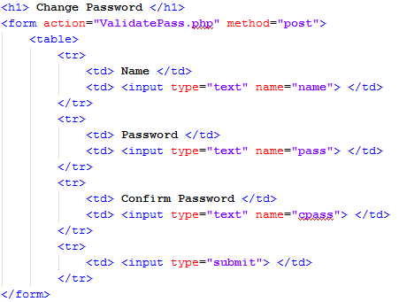
3. String Functions in PHP…

Slide 31
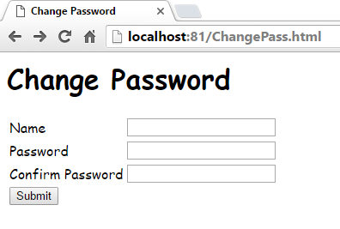
3. String Functions in PHP…
Post to ValidatePass.php

Slide 32
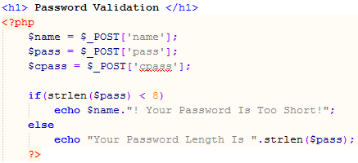
3. String Functions in PHP…
Getting Variables
Using strlen()

Slide 33
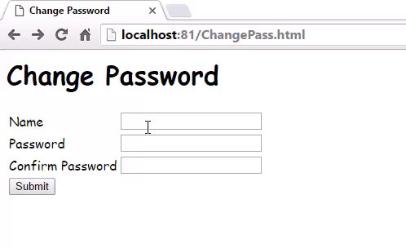
3. String Functions in PHP…

Slide 34
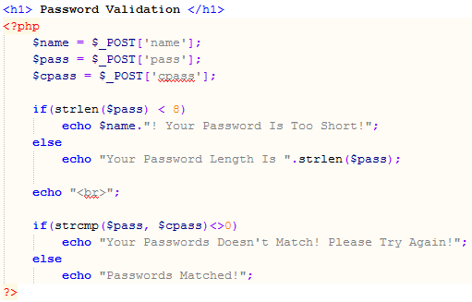
3. String Functions in PHP…
Compares Pass and cPass

Slide 35

3. String Functions in PHP…

Slide 36
3. String Functions in PHP…
strtolower():
Convert a string in lower case
strtolower($string);
strtoupper():
Convert a string in upper case
strtoupper($string);
ucfirst():
Convert the first character of a string to upper case
ucfirst($string);
ucwords():
Convert the first character of each word in a string to upper case
ucfirst($string);

Slide 37
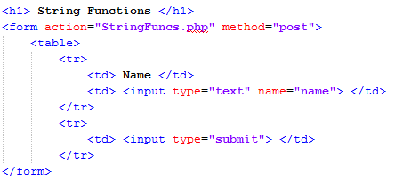
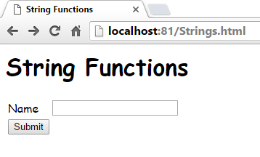
3. String functions in PHP…

Slide 38
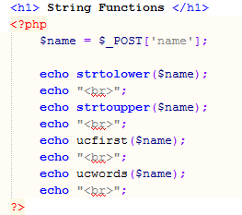
3. String functions in PHP…
Converts to Lowercase
Converts to Uppercase
Using ucfirst()
Using ucwords()

Slide 39
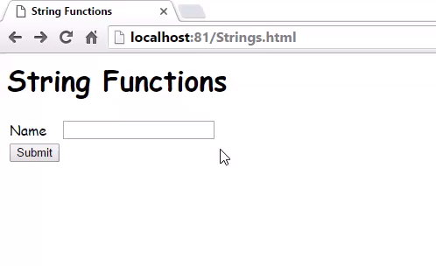
3. String functions in PHP…

Slide 40
3. String Functions in PHP…
strpos():
finds the position of the first case-sensitive occurrence of a substring in a string
strpos($string,sub-string);
strrpos():
finds the position of the last case-sensitive occurrence of a substring in a string
strrpos($string,sub-string);
substr_count():
returns the number of times one string occurs within another
substr_count($string,sub-string);

Slide 41
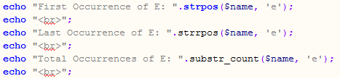
3. String functions in PHP…
First Occurrence of ‘E’
Last Occurrence of ‘E’
All Occurrences of ‘E’

Slide 42
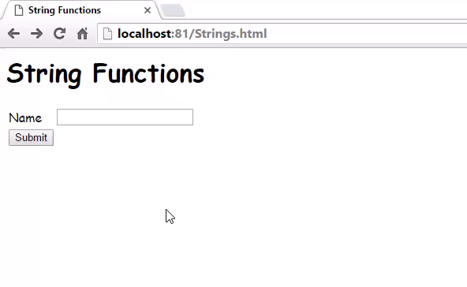
3. String functions in PHP…

Slide 43
Summary of PHP Lectures
Setting the environment
PHP overview
What is a PHP File
Open-source
Platform independent
What Can PHP Do?
Why PHP?
Basic PHP Syntax
Writing and Executing PHP Code
PHP constants
Constants are Global
PHP variables
Local
Global
Static
Type Determination
PHP Strings
PHP is a Loosely Typed Language

Slide 44
Summary of PHP Lectures
Operators in PHP
Arithmetic Operators: +, - ,*, /, %, **
Assignment Operators: =
String Operators: . , .=
Increment/decrement Operators: ++ , --
Logical Operators: AND, OR, NOT, XOR, &&, ||, !
Comparison Operators: >, <, <=, >=
Equality Operators: ==, !=, ===
Conditional statements
if statement - executes some code if one condition is true
if...else statement - executes some code if a condition is true and another code if that condition is false
if...elseif....else statement - executes different codes for more than two conditions
switch statement - selects one of many blocks of code to be executed

Slide 45
Summary of PHP Lectures
Looping statements
For Loop
While Loop
Do-While Loop
ForEach Loop
Arrays in PHP
Associative arrays
Sorting arrays

Slide 46
Summary of PHP Lectures
Passing Form Data
action
method (POST or GET)
When to Use GET?
When to Use POST?
Compare GET vs. POST
Super Global Variables

Slide 47
Summary of PHP Lectures
Passing data with forms
Passing Text Field Data
Passing Hidden Field Data
Getting Value From Checkbox
Getting Value From Radio Button
Getting Value From Select List
Using session Variables

Slide 48
Summary of Today’s Lecture
Writing regular expression in PHP
Brackets []
Quantifiers +, *, ?, {int. range}, and $
Sub-patterns
Predefined character ranges\d:\D:\w:
Validating User’s Input
Validating name:
Validating Password:
Validating date:
Validating CNIC:
Validating Email:
Validating user’s input

Slide 49
Summary of Today’s Lecture
Defined functions.
preg_match():
preg_match_all():
preg_grep():
String Functions in PHP
strlen():
strcmp():
strcasecmp():
strtolower():
strtoupper():
ucfirst():
ucwords():
strpos():
strrpos():
substr_count():

Slide 50
THANK YOU

